Slide 1



GPS INTERFACING WITH ATMEGA328P
ECE342: EMBEDDED SYSTEM ARCHITECTURE AND PROGRAMMING

Slide 2
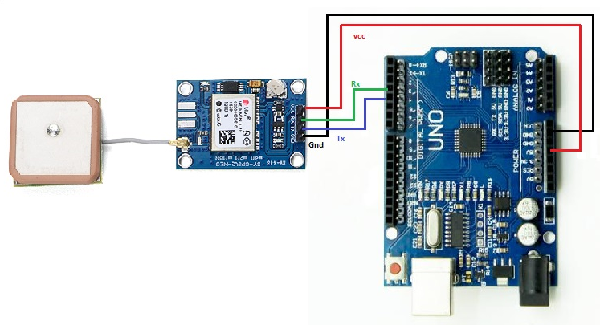
INTRODUCTION
Global Positioning System (GPS) makes use of signals sent by satellites in space and ground stations on Earth to accurately determine their position on Earth.
Radio Frequency signals sent from satellites and ground stations are received by the GPS. GPS makes use of these signals to determine its exact position.
The GPS itself does not need to transmit any information.

Slide 3
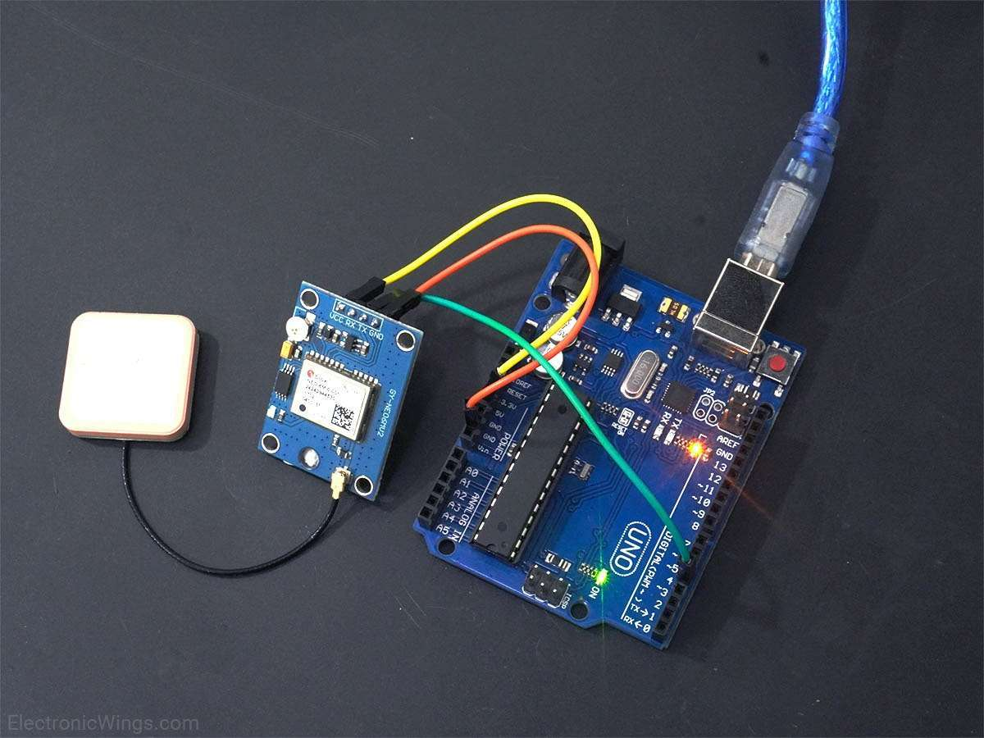
Components used
GPS RECEIVER MODULE
ARDUINO UNO WITH ATMEGA328P
JUMPER WIRES
BREADBOARD

Slide 4
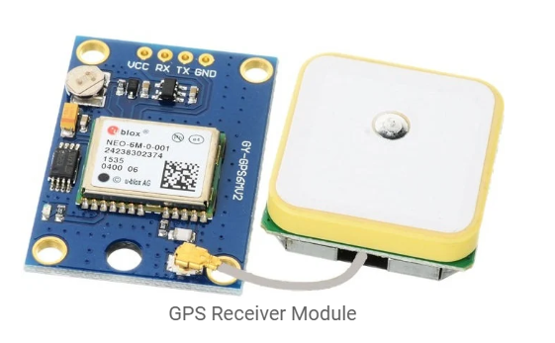
GPS RECEIVER MODULE
GPS receiver uses a constellation of satellites and ground stations to calculate accurate location wherever it is located.
These GPS satellites transmit information signal over radio frequency (1.1 to 1.5 GHz) to the receiver. With the help of this received information, a ground station or GPS module can compute its position and time.

Slide 5
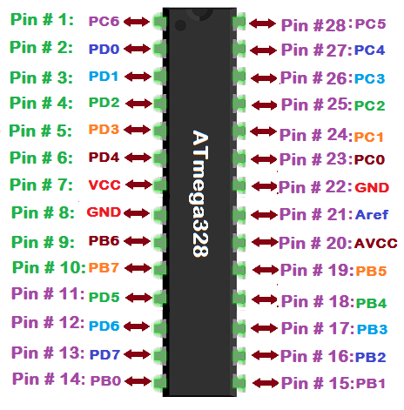
ATMEGA328P
The Atmel 8-bit AVR RISC-based microcontroller combines 32 KB ISP flash memory with read-while-write capabilities, 1 KB EEPROM, 2 KB SRAM, 23 general-purpose I/O lines, 32 general-purpose working registers, 3 flexible timer/counters with compare modes, internal and external interrupts, serial programmable USART, a byte-oriented 2-wire serial interface, SPI serial port, 6-channel 10-bit A/D converter (8 channels in TQFP and QFN/MLF packages), programmable watchdog timer with internal oscillator, and 5 software-selectable power-saving modes.

Slide 6
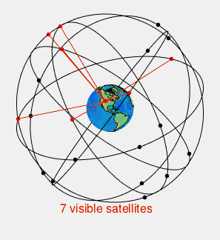
WORKING -
To use a GPS module with an ATmega328P microcontroller, you would typically connect the GPS module to the microcontroller via a serial connection. The GPS module sends NMEA data to the microcontroller over this connection, which includes information about the GPS location, date, time, and other relevant data.
To receive and process this NMEA data on the ATmega328P, you would typically use a software serial library, such as the SoftwareSerial library in the Arduino IDE. This allows you to create a serial connection on any two pins of the ATmega328P, which you can use to receive and transmit data from the GPS module.Once you have established a serial connection between the GPS module and the ATmega328P, you can use a GPS library, such as TinyGPS, to parse the NMEA data and extract the relevant information about the GPS location, date, time, etc. This library provides functions that allow you to access this information easily and display it on an LCD or serial monitor.

Slide 7
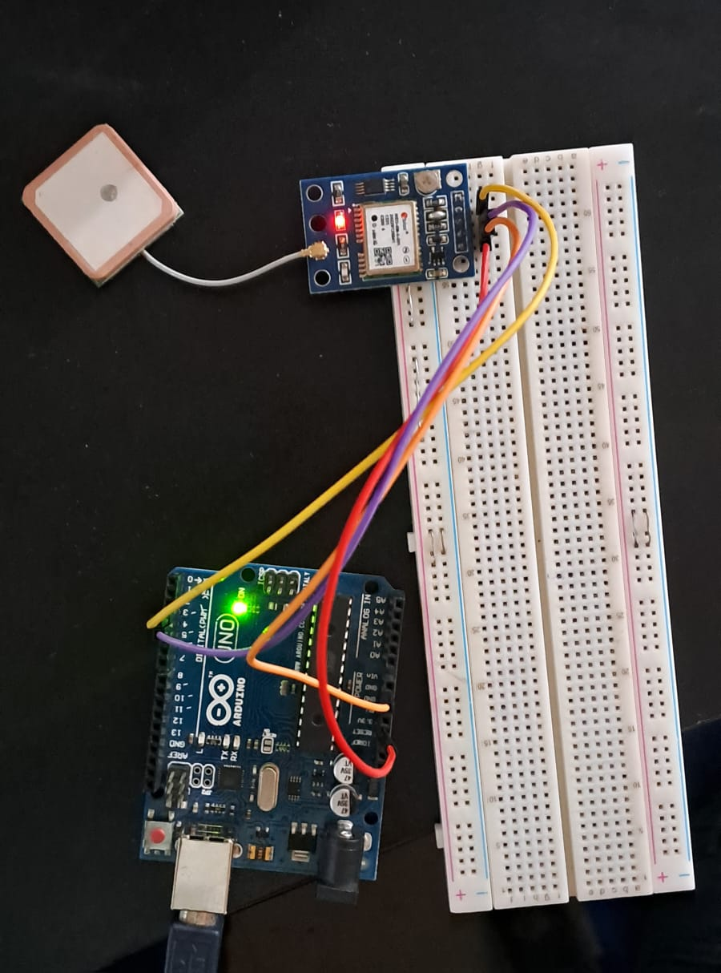
CIRCUIT

Slide 8

THANK YOU

